Slide 1



Senior Year
What you need
to know
to succeed
Notes:
Today we are going to give you some tips to being successful in school this year and beyond. Your freshman year is a foundation for the rest of high school. What you do this year greatly impacts the rest of your high school career. We are here to help you be successful. If you need assistance, please be sure to ask.

Slide 2
Senior Meeting Agenda
Introductions of guidance staff
Planning for after high school
Assessments
Success through College Preparation
Financial Aid – Bright Futures and other scholarships
Graduation Requirements (academic)
Activities & costs

Slide 3
Your Guidance Staff
Ms. Karaki – Counselor for Dance, Tech. Theater, Visual Art, Creative Writing, Drama
Mr. Arrington – Counselor for Band, Orchestra, and Vocal
Mrs. Gill – College and Career Counselor
Mrs. Frederick- School Social Worker
Mrs. Millan – Guidance Secretary (keeps us all organized!)
Mrs. Gleason-Data Entry/Attendance
Notes:
Who are we? Each of the guidance staff will introduce themselves. Ms. Roman will cover assessment. Ms. Hart will cover Prep HQ and PIV so you can start now to prepare for college or work. Mr. Arrington will go over credits and GPA calculation.

Slide 4

Planning for After High School
Mrs. Gill will be conducting interviews with each senior
College or Career in your future?
College Week Activities
College Application Day – assist you to complete college applications or search for employment.

Slide 5
ASSESSMENTS
ACT
SAT
PERT
. FSA
PERT – Post-Secondary
Readiness Test
Notes:
Hopefully most of you have completed the FCAT requirement. If not, the FCAT re-take will be held in October. The ACT and SAT are mandatory if you plan to go to college. They also can serve as a substitute for FCAT scores. And you may want to take one of these tests so you are assured of completing the test score requirement for graduation. The CPT is not given to all 11th graders and if you pllan to go to

Slide 6
What is the difference between the ACT and SAT?
Differences between the tests
ACT | SAT
Four Multiple choice sections – Math, English, and Science | 3 sections Math, Evidence Based Reading and Writing, Optional Essay
Max Score – 36 per section | Score 200-800 per section
Content based - achievement | Analyze and Solve problems - aptitude
No penalty for guessing | No penalty for guessing
Writing test in optional | Optional essay
Career interest inventory | Inventory Not provided
Similarities of the tests
Predictor for college success | Predictor for college success
Used by college to determine admission | Used by college to determine admission
Bright Future Scholarship criteria | Bright Future Scholarship criteria
College specific Scholarships | College specific scholarships
Notes:
The ACT is an achievement test, measuring what a student has learned in school. The SAT is more of an aptitude test, testing reasoning and verbal abilities.
The ACT has up to 5 components: English, Mathematics, Reading, Science, and an optional Writing Test. The SAT has only 3 components: Verbal, Mathematics, and a required Writing Test.
The College Board introduced a new version in 2005, with a mandatory writing test. ACT continues to offer its well-established test, plus an optional writing test. You take the ACT Writing Test only if required by the college(s) you're applying to.
The SAT has a correction for guessing. That is, they take off for wrong answers. The ACT is scored based on the number correct with no correction for guessing.
ACT lets the student decide what set of scores they want sent. The College Board's policy is to send all scores.
The ACT has an interest inventory that allows students to evaluate their interests in various career options.

Slide 7
What is the ACT?
The ACT is a national college admission examination that consists of subject area tests in: English Mathematics Reading Science
The ACT Plus Writing includes the four subject area tests and a 30-minute Writing Test.
ACT results are accepted by virtually all U.S. colleges and universities.
The ACT includes 215 multiple-choice questions
Actual testing time is 2 hours and 55 minutes (plus 30 minutes if you are taking the Writing Test).
Takes approximately 3 hours and 30 minutes to complete with breaks (or just over four hours if you are taking the Writing Test).
The ACT is administered on five test dates—in October, December, February, April, and June. In selected states, the ACT is also offered in September.
The basic registration fee includes score reports for up to four college choices for which a valid code is listed at time of registration.
Notes:
The ACT is universally accepted for college admission in the U.S. The ACT is accepted by virtually all colleges and universities in the U.S., including all the Ivy League schools.
The ACT multiple-choice tests are curriculum based. The ACT is not an aptitude or an IQ test. Instead, the questions on the ACT are directly related to what you have learned in your high school courses in English, mathematics, reading, and science. Because the ACT tests are based on what is taught in the high school curriculum, students are generally more comfortable with the ACT than they are with traditional aptitude tests or tests with narrower content.
The ACT is more than a test. In addition to the tests, the ACT also provides test takers with a unique Interest Inventory that provides valuable information for career and educational planning and a student profile section that provides a comprehensive profile of your work in high school and your future plans.
The ACT is a good value. As a private, not-for-profit organization governed by educators, ACT is committed to providing services at the lowest possible cost. Accordingly, the ACT provides a comprehensive package of educational assessment and career planning services for college-bound students at a modest fee that is lower than the fee for the competing admissions test.

Slide 8

What does it cost?
The 2021–2022 basic fee for the ACT Plus Writing is $85.00
The basic fee for the ACT if you don't take the Writing Test is $60.00
Notes:
This includes score reports for up to four college choices for which a valid code is listed as part of registration.

Slide 9
Am I eligible for a fee waiver?
To be eligible, you must meet ALL three of the following requirements:
You currently attend high school in the United States, U.S. territories, Puerto Rico, or Canada, as a junior or senior.
You meet at least one indicator of economic need listed on the ACT fee waiver form. Information about these indicators and how to request fee waiver forms is mailed each fall to every high school. Ask your counselor for the information.
If you are eligible, you may use up to two fee waivers total. The waiver has been used once you register, even if you do not test on the requested test date.
ACT uses paper waivers, see Mrs. Gill if you need one.
Fee waivers cover only the basic registration fee for the test option selected when registering, including up to four valid college choices (listed as part of registration). Waivers do not cover the late fee, test date changes, test center changes, or any other fees.
Notes:
If you can't afford the registration fee for the ACT (No Writing) or ACT Plus Writing, you may be eligible for an ACT Fee Waiver. Funds are limited, and once they are gone, requests for waivers will be denied.
For more information, see your high school guidance office. Follow the instructions on the waiver form.

Slide 10
Tips for Taking the ACT
Carefully read the instructions on the cover of the test booklet.
Read the directions for each test carefully.
Read each question carefully.
Pace yourself—don't spend too much time on a single passage or question.
Pay attention to the announcement of five minutes remaining on each test.
Use a soft lead No. 2 pencil with a good eraser; do not use a mechanical pencil or ink pen.
Answer the easy questions first, then go back and answer the more difficult ones if you have time remaining on that test.
On difficult questions, eliminate as many incorrect answers as you can, then make an educated guess among those remaining.
Answer every question. Your scores on the multiple-choice tests are based on the number of questions you answer correctly. There is no penalty for guessing.
If you complete a test before time is called, recheck your work on that test.
Mark your answers properly. Erase any mark completely and cleanly without smudging.
Do not mark or alter any ovals on a test or continue writing the essay after time has been called. If you do, you will be dismissed and your answer document will not be scored.
If you are taking the ACT Plus Writing, see these Writing Test tips.

Slide 11
The SAT
The SAT Reasoning Test, better known as the SAT
. 3-hours,
Measures critical thinking, reasoning, and writing skills
The SAT is standardized across all students, schools, and states, providing a common and objective scale for comparison.
65 Minute Reading Section, 35 minute writing and lang. section
52 Reading Questions, 44 Writing and Lang. Questions
Test-takers sitting next to each other in the same session may have test books with entirely different content orders.
Each section scored on a scale of 200-800
Typically taken by high school juniors and seniors.
Administered seven times a year in the U.S., Puerto Rico and U.S. Territories

Slide 12
SAT Preparation Center
Know what to expect on test day by reviewing practice questions, taking a practice test, and more.
Official SAT Practice Questions
Review directions, approaches, and practice questions:
Critical Reading | Mathematics | Writing
The Official SAT Question of the Day
Practice with a daily question, hint, and explanation.
Official SAT Practice Test
Print and take a practice test, then get a score report and answer explanations.
Khan Academy
March 2 Success

Slide 13

What Does it Cost?
SAT Evidence Based Reading and Writing- $55.00
SAT will be Given at OCSA on October 13th during a school day to all seniors.

Slide 14
SAT Program Fee-Waiver Service
Fee-Waiver Cards
Cover the basic test fees for SAT or SAT Subject Tests.
Cover the cost of four additional score reports.
Cover either the Question-and-Answer Service (QAS) or the Student Answer Service (SAS) (if you select these services when you register).
May qualify you for application fee waivers at many colleges, if the institution has agreed to cooperate with the SAT Program Fee-Waiver Service.
Check your college board account to see if a waiver is there, if not see Mrs. Gill.
Eligibility
You are eligible for consideration for fee waivers if you are:
an American citizen or a foreign national testing in the United States, Puerto Rico, or United States territories; or
an American citizen living outside the United States; and
you meet the financial eligibility guidelines for fee waivers, such as participating in the Federal Free and Reduced Lunch/National School Lunch Program at your school. Your guidance counselor will share and additional eligibility guidelines with you.
.

Slide 15
SAT Test Taking Approach
Answer easy questions first. The easier questions are usually at the start of the section, and the harder ones are at the end. The exception is in the critical reading section, where questions are ordered according to the logic and organization of each passage.
Make educated guesses. If you can rule out one or more answer choices for multiple-choice questions, you have a better chance of guessing the right answer.
Answer every question. Your scores on the multiple-choice tests are based on the number of questions you answer correctly. There is no penalty for guessing
Limit your time on any one question. All questions are worth the same number of points. If you need a lot of time to answer a question, go on to the next one. Later, you may have time to return to the question you skipped.
Keep track of time. Don't spend too much time on any group of questions within a section.
Use your test booklet as scratch paper.
Mark the questions in your booklet that you skipped and want to return to.
Check your answer sheet to make sure you are answering the right question

Slide 16
How colleges use ACT/SAT results
Admission decisions
Test results, high school grades, academic preparation, out-of-class accomplishments, special interests, and future plans—these and other kinds of information help admission officials identify applicants who can benefit most from their programs.
Course placement
Colleges usually try to take into account individual strengths and weaknesses as they place students in freshman-year courses. For example, a college may offer three sections of a subject—developmental, regular, and advanced. A student's test results, academic background, and high school grades might be used to determine which section would be most appropriate.
Academic advising
College academic advisers may consider test results, high school academic program, high school grades, college grade estimates, planned extracurricular activities, areas in which there is a need for help, and part-time employment plans to help a student tailor an appropriate program of study.
Scholarships and loans
Some scholarship and loan agencies may use test results and grade predictions, with other information such as high school grades, to identify qualified candidates. However, the agencies may not look only at academic potential. The ACT score report provides information about a student's educational needs, extracurricular achievements, and educational plans. This information, along with high school grades and test scores, helps the agencies evaluate applications for scholarships, loans, and other financial assistance.

Slide 17
Accommodations for the SAT/ACT
If you are seeking accommodations on these tests for an IEP or 504, it is highly suggested that you take the August-May testing only.

Slide 18
PERT
Florida community colleges, administer the PERT, which is a college placement test.
The test is generally administered on the computer .
The test measures reading, writing, and algebra skills.
It is untimed but most students take approximately two hours to complete the test.
Selected Juniors/sophomores will take this test at OCSA.
This test will be used to determine if juniors are college ready and for dual enrollment entrance.
Notes:
Juniors will take this test and it will determine if remediation for college will be necessary. IF you also have SAT or ACT scores then any college ready score in the subject area will be used to keep you from going into college remediation classes.

Slide 19

FSA 2021
RETAKES/ NEW STUDENTS
Must pass in order to graduate
Re-takes are usually in September/October
Practice…practice… practice…..

Slide 20

GRADUATION REQUIREMENTS
WHAT YOU NEED TO KNOW!
Ms. Karaki, School Counselor
Counsels Drama, Dance, Creative Writing, Tech, Visual Arts
Mr. Arrington, School Counselor
Counsels Band, Orchestra and Vocal

Slide 21
SUBJECT AREA REQUIREMENTS
English - 4 CREDITS
MATHEMATICS – 4 CREDITS (Algebra I, Geometry)
SCIENCE – 3 CREDITS (Biology, 2 Rigor)
SOCIAL STUDIES – 3 CREDITS
WORLD HISTORY – 1
AMERICAN HISTORY – 1
AMERICAN GOV’T – .5
ECONOMICS - .5

Slide 22
SUBJECT AREA
REQUIREMENTS CONTINUED
Physical Education - HOPE - 1
World Languages/Elective– 2
Pass FSA Reading in 10th grade
Pass Algebra I EOC
Take One Online Class
24 TOTAL CREDITS FOR GRADUATION, MOST OCSA STUDENTS EARN 28

Slide 23
Grade Point Average
Unweighted GPA
Grade=Quality Pts.
A = 4.0
B = 3.0
C = 2.0
D = 1.0
F = 0.0
Weighted GPA
Grade=Quality Pts.
AP & D E Honors
Classes
A = 5.0 4.5
B = 4.0 3.5
C = 3.0 2.5
Notes:
23
Grade point average is computed by dividing the attempted credits into the quality points received based on the class grades.

Slide 24
Activities and Costs
Senior Pictures
Cap, Gown, Ring, Announcements etc.
College Visits
College applications
Entrance Tests
Prom
Grad Night/Bash
Yearbook

Slide 25

Mrs. Gill,
Career & College Counselor
Notes:
Raise your hand if you registered for Prep HQ as an 8th grader? Stand if you completed your four year plan on FACTS.org. Stand and raise your hand if you participated in the career program Choices Planner. I will be working with anyone who doesn’t have a four year plan to help you build one. I will do some classroom guidance as I have time – probably on how to use Prep HQ and PIV to be more successful. The bulk of my work with be with your Juniors and Seniors.

Slide 26
Why Go to College?
Expected lifetime earnings
Professional degree | $4.4 million
Doctoral degree | $3.4 million
Master's degree | $2.5 million
Bachelor's degree | $2.1 million
Associate's degree | $1.6 million
Some college | $1.5 million
High school graduate | $1.2 million
Non-high school graduate | $1 million
Source: U.S. Census Bureau
Every bit of education you get after high school increases the chances you'll earn good pay.
The more education you get the more likely it is you will always have a job.
Continuing education after high school is much more important for your generation than it was for your parents' generation.
Education beyond high school gives you a lot of other benefits

Slide 27
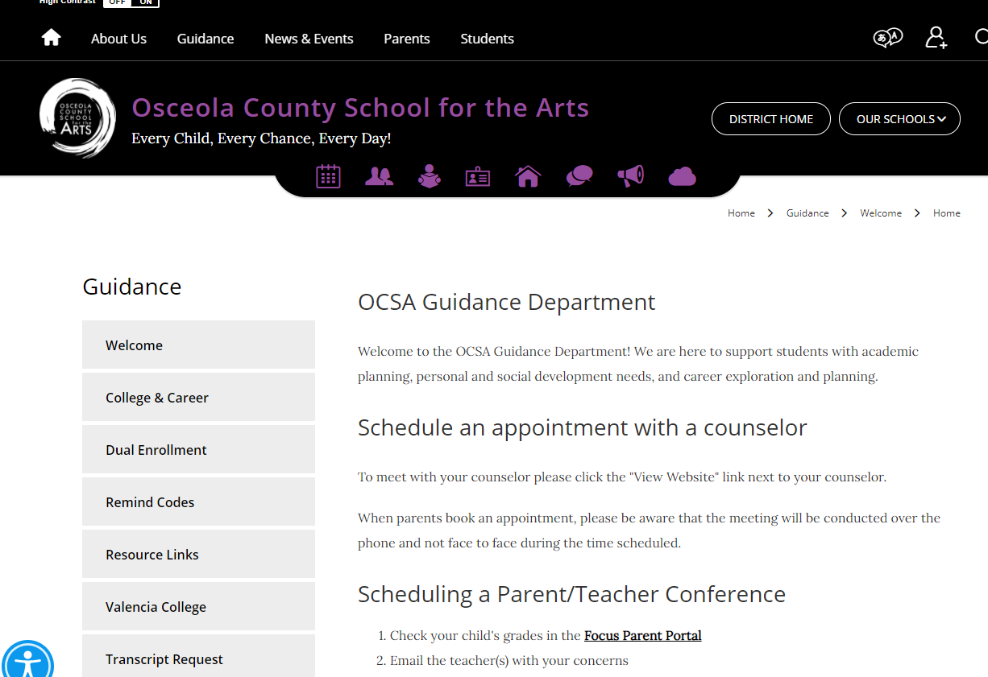


Slide 28

Get Organized
Get your portfolio in order/resume
Write a generic essay for colleges and scholarships
Register for a college entrance test - NOW
Use Remind text to see important announcements about scholarships and college visits.
Apply to colleges online-NOW.
Check your grades online frequently.
Hand in copies of college acceptance letter and scholarships
No resume=No Rec letter!
Notes:
One of the areas I can be of help is with being more organized in your life so you will be more successful. First you need a portfolio for all the paperwork you receive during your high school career. Awards, letters, report cards, FCAT scores, community service hours documentation; credit evaluation forms etc.
Prep HQ is a Web based guidance program for high school students with an electronic organizer. It is the way I will communicate with you and your parents
Prep HQ has an area called my organizer that helps you keep track of your volunteer activities, employment, extra curricular activities such as plays you were part of or band competitions etc. Use that to make resume writing easy.
Finally, it’s important to be organized in your classes. Stay on top of assignment due dates and test dates. Don’t turn in late work – it is often not accepted. Have a routine for studying. Same time and place where there are few distractions. Can someone tell me what I mean by that? Keep up with your grades – use PIV to see what you earned on assignments and what assignments you haven’t turned in. Raise your hand if you have ever accessed PIV. I can work with students to show you how to access PIV.

Slide 29
Bright Futures Update
FAS – Academic Scholars
Credits: - 16
GPA – 3.5 BF weighted
Community Service –
100 hours
Test Scores: SAT- 1330 Cr. Reading and Math
Or ACT 29
2 years of same Foreign Language
FMS – Medallion Scholars
Credits: 16
GPA – 3.0 BF weighted
Community Service –
75 hours
Test Scores: SAT:1210
Cr. Reading and Math
Or ACT 25
2 years of same Foreign Language

Slide 30
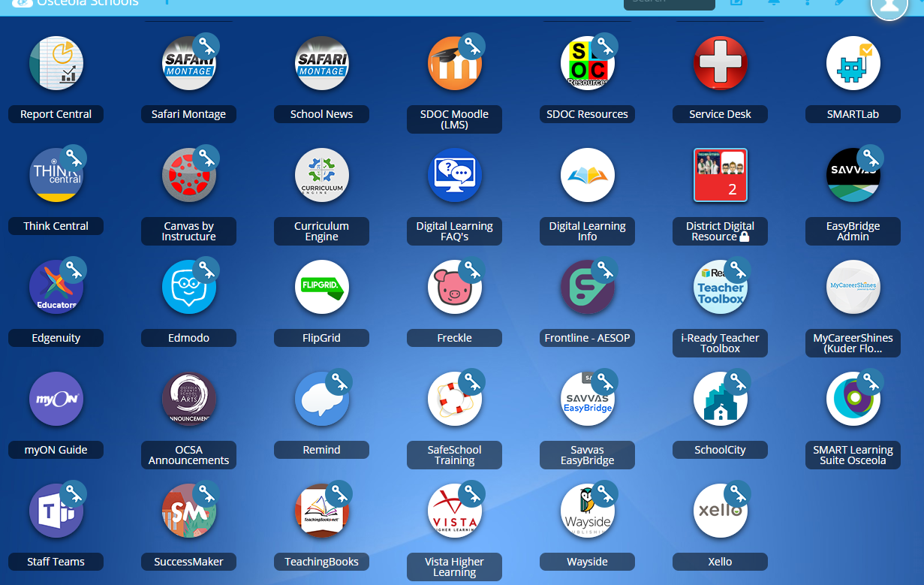

XELLO

Slide 31
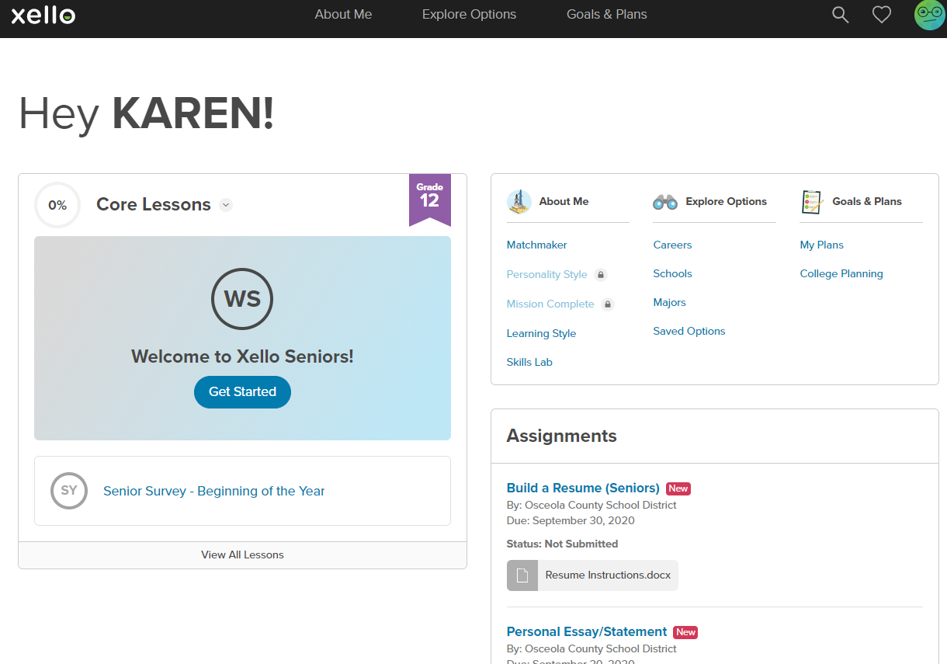
XELLLO

Slide 32
@OCSACLAS
Remind Code for Class of 2022

Slide 33
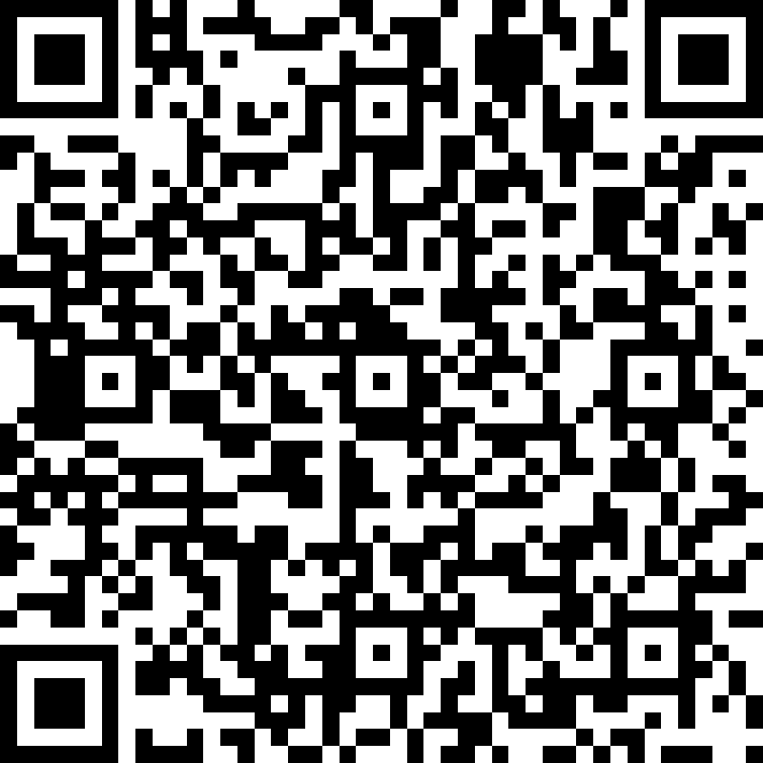
Beginning of the Year Check-In
The counseling team would love to get to know you! This information will help us when we meet with you individually.
Your information will only be shared with the following people: Mr. Arrington, Ms. Karaki, Ms. Gill, and Ms. Fredrick.
Exception: Safety issues

Slide 34

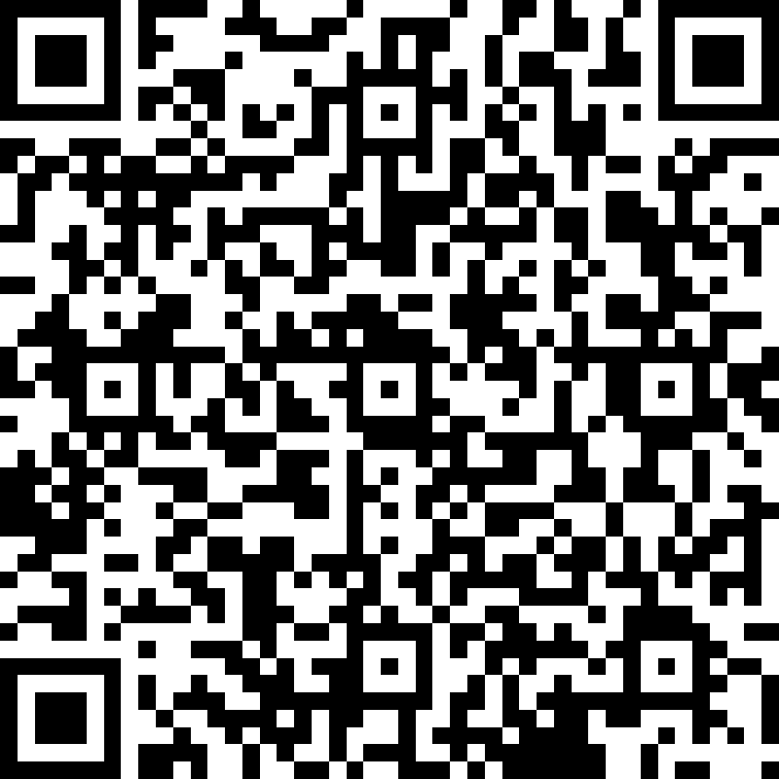
Senior Survey-Beginning of the Year
MANDATORY!!!!!
Please fill out this survey now. We would like to know your plans for after high school graduation, so we know how to assist you. :)

Slide 35
Question & Answer
We will be available to answer any questions.
Have A Successful Year!

